Slide 1
Port 1
Tobi Prais - st20226583

Slide 2
Brief
To create assets, textures, animations, sounds and level designs for a potential remake and DLC of Populous 2 (1991).

Slide 3
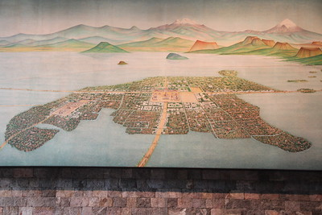
Level Design- Concept
The basis for these levels is Tenochtitlan, the capital of the Aztec Empire.
This means the map will be inspired by the landmass on which Tenochtitlan was built, and the game models will be inspired by Aztech architecture.
The images used in reference for the map was taken by Gary Todd (2013).
Notes:
https://education.nationalgeographic.org/resource/tenochtitlan/
https://www.flickr.com/photos/101561334@N08/9755215791/

Slide 4


Game Map
To create the game map, first a simple outline was created based on the image.
Next, the map is created out of squares following the simple outline that was previously created. The map is created out of squares as this mimics how the terrain is structured in Populous 2.

Slide 5
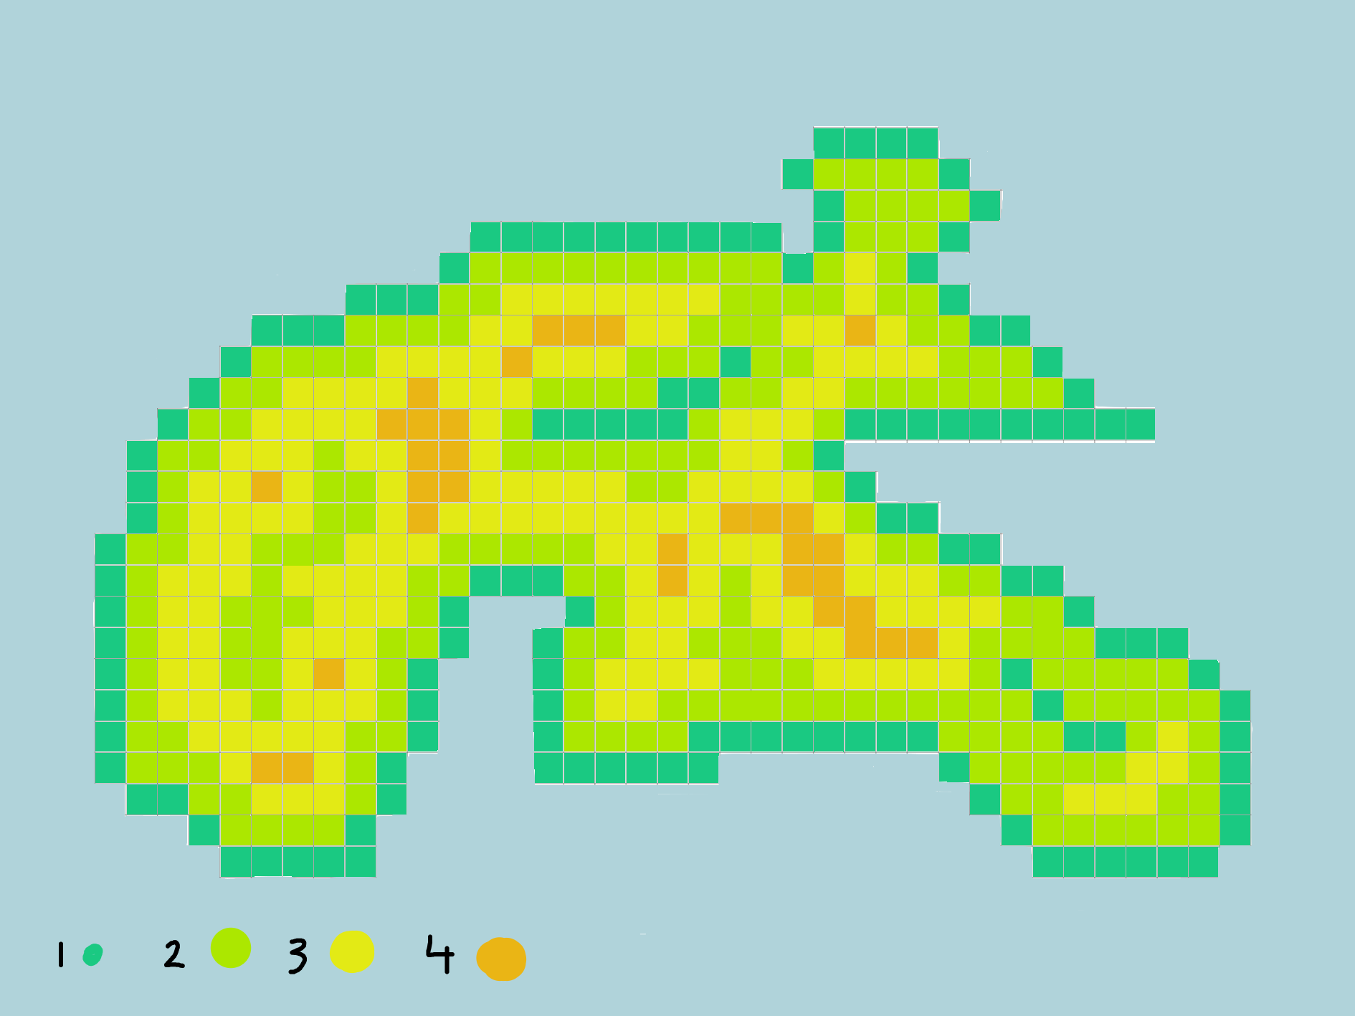
Game Map
Finaly, elevation is added to the game map. At the bottom of the image, a key is displayed indicating what elevation relates to each colour.

Slide 6
Level design – Progression
The first level will have the basic rules of Populus 2 (1991). Where all land elevations can be edited, enemy locations are shown on the map and disasters are shown on the map. The enemy AI will also not be very aggressive in the beginning levels.
As the levels progress the enemy AI will become more aggressive, eventually fully prioritizing attacking over creating settlements.
At 5th level, enemy locations will no longer be shown on the map.
At 7th level, the player will no longer be able to change the land elevations on and in the near vicinity of the enemy's settlements.
At 10th level, disasters will no longer be shown on the map.
The level increases after each player win.

Slide 7
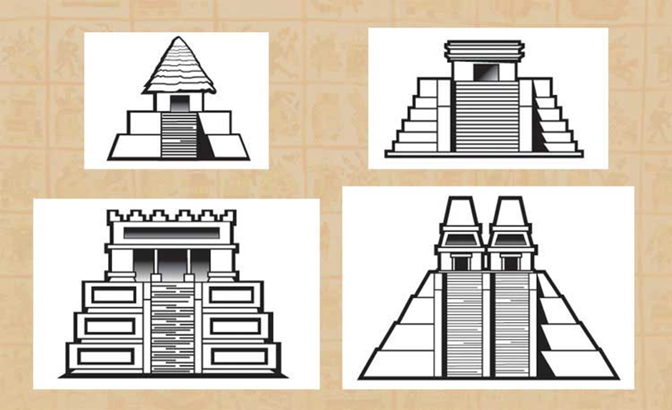
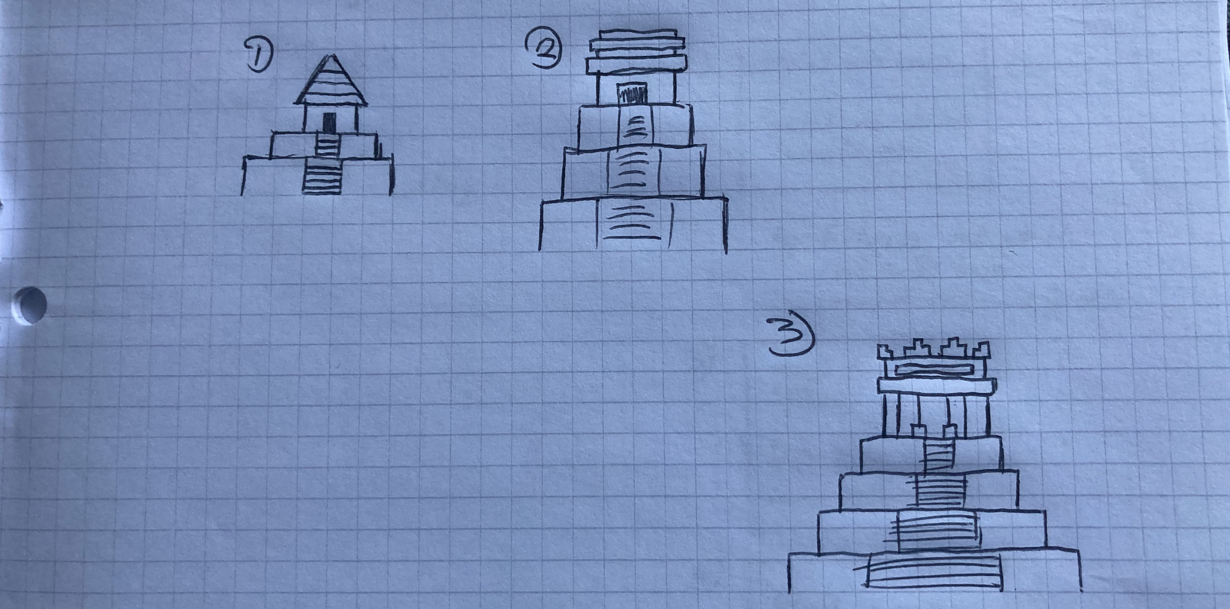
Modeling
The main three models are inspired by Aztec temples.
The first one has two levels and a mud brick hut for a temple.
The second one has 3 levels, a stone temple and engravings on the sides of the temple.
The third one has 4 levels and a much more complex design.
The concept art was inspired heavily by information found online (Mexicolore, 2016).

Slide 8
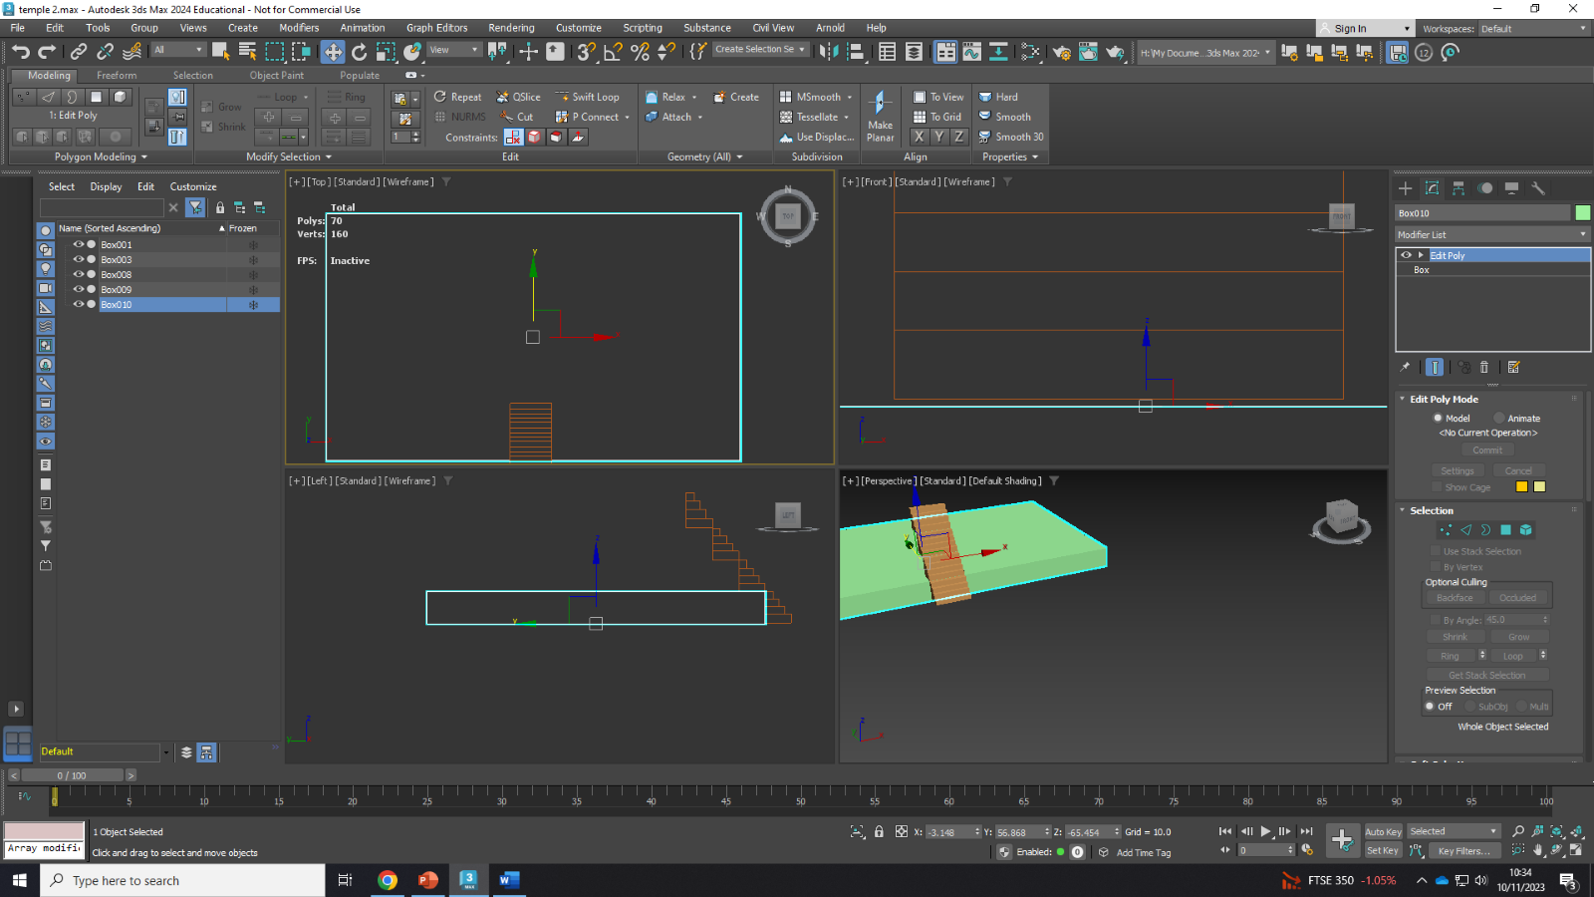
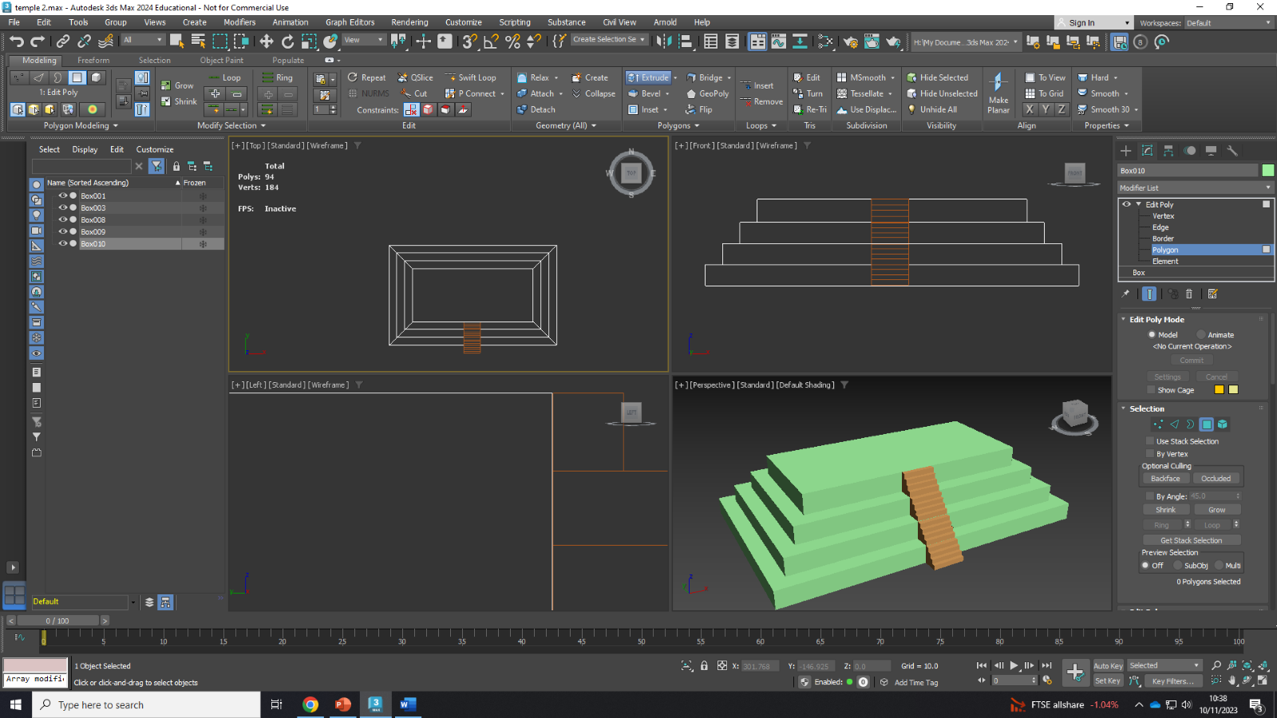
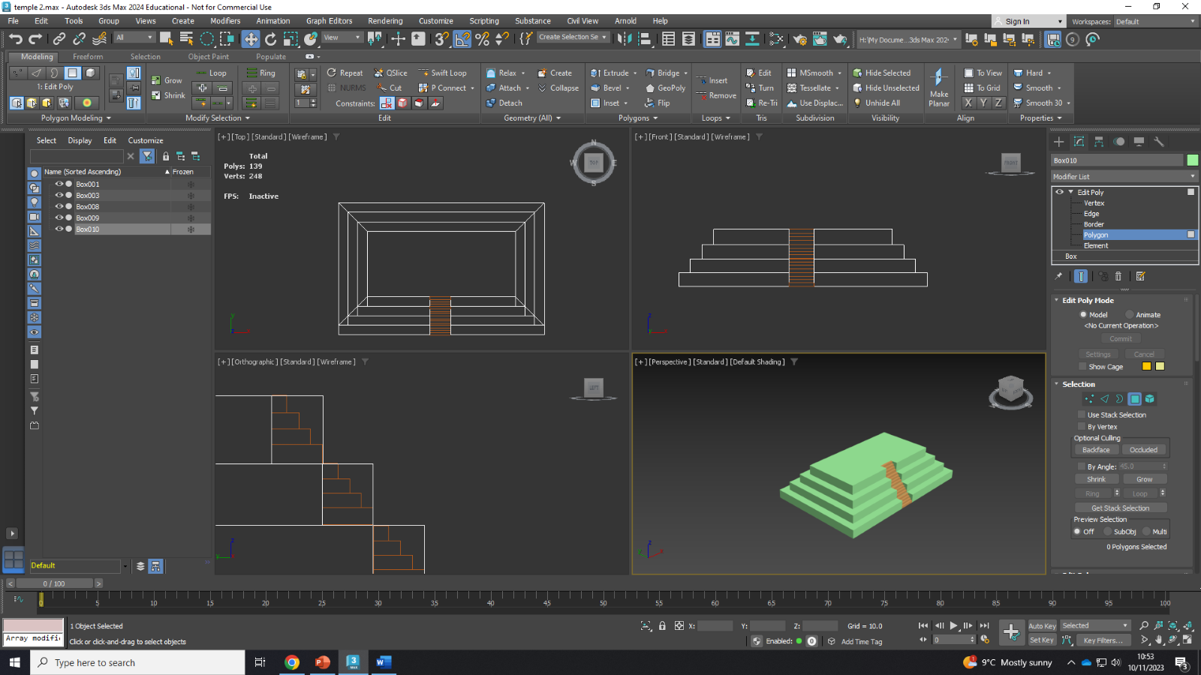
Modeling (temple 3)
The stairs are created by making a rectangle, using swift loop and extruding the new area multiple times
The temple pyramid is created in a similar way however the inset tool is used to create an equal distance between the edges of the temple steps on each side.
The sides of the temple are extruded out to match the edges of the stairs. They are extruded out as when extruding in to create a well for the stairs was attempted it left unwanted geometry and created Ngons.
Non-visible faces are removed.

Slide 9
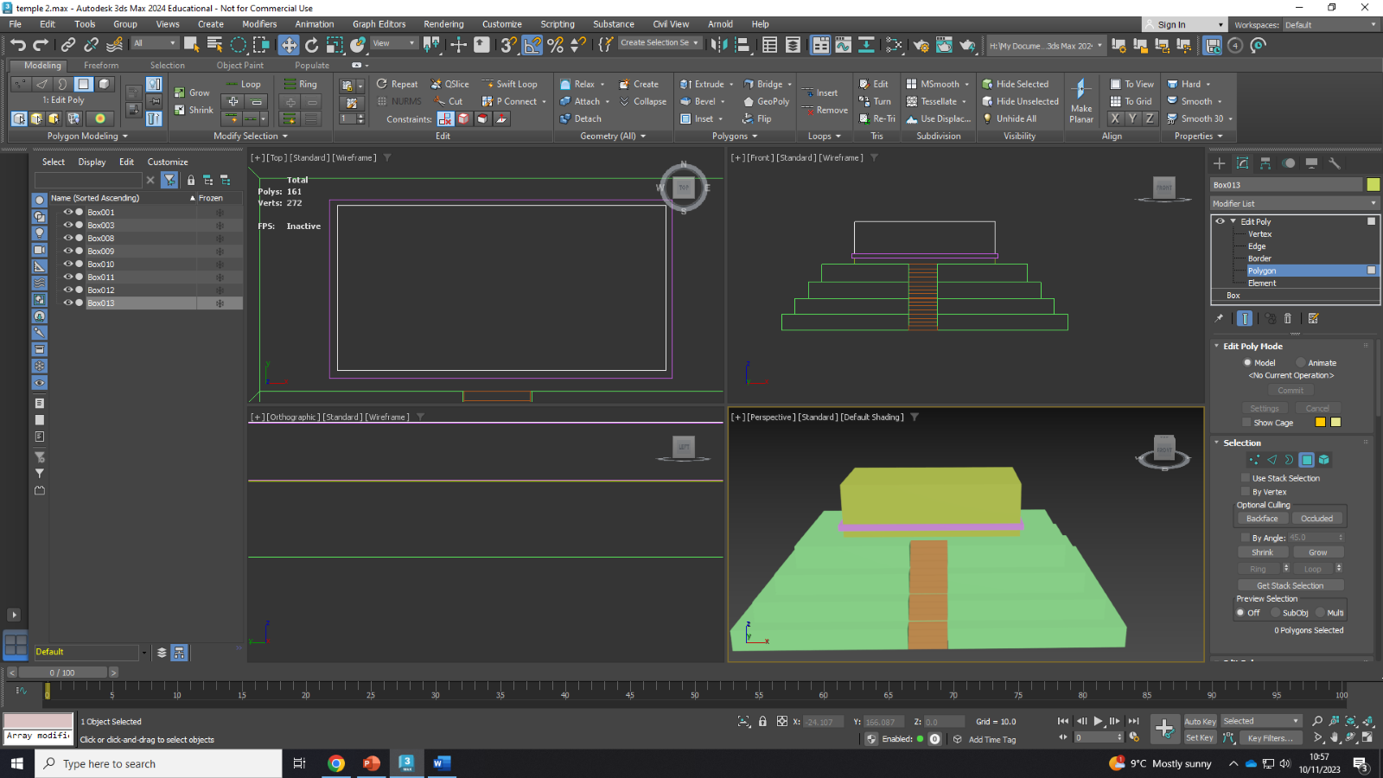
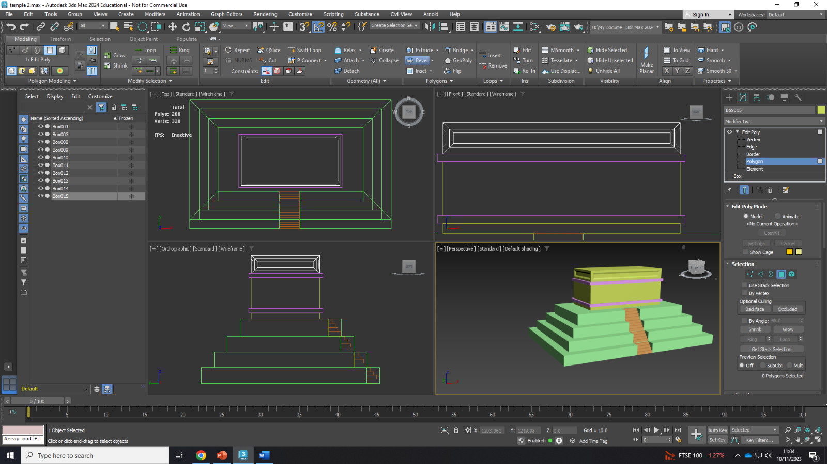
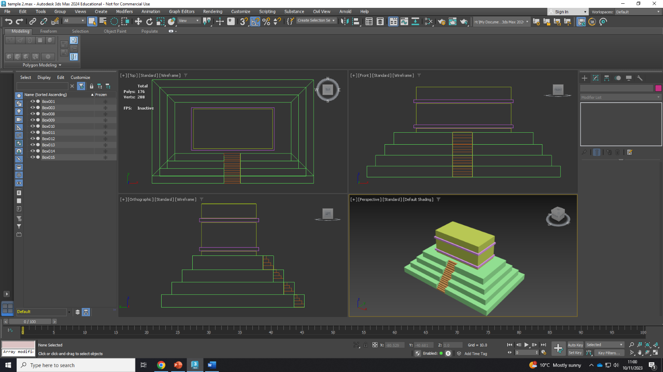
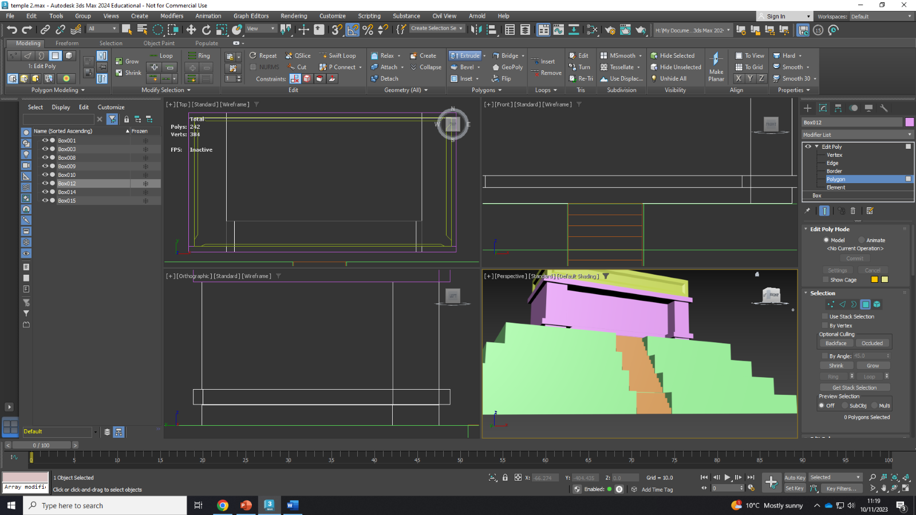
Modeling ( temple 3)
The top band of the temple is inset and then a bevel is added to create more elaborate detail on the temple.
Swift loop is added to the main body of the temple and each component of it is extruded inward to create a doorway.
Boxes are added to create the temple.
Non-visible faces are removed.

Slide 10
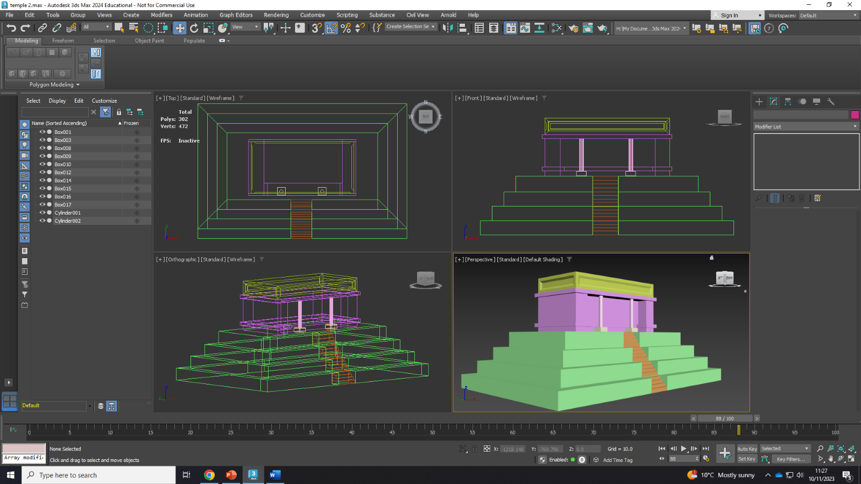
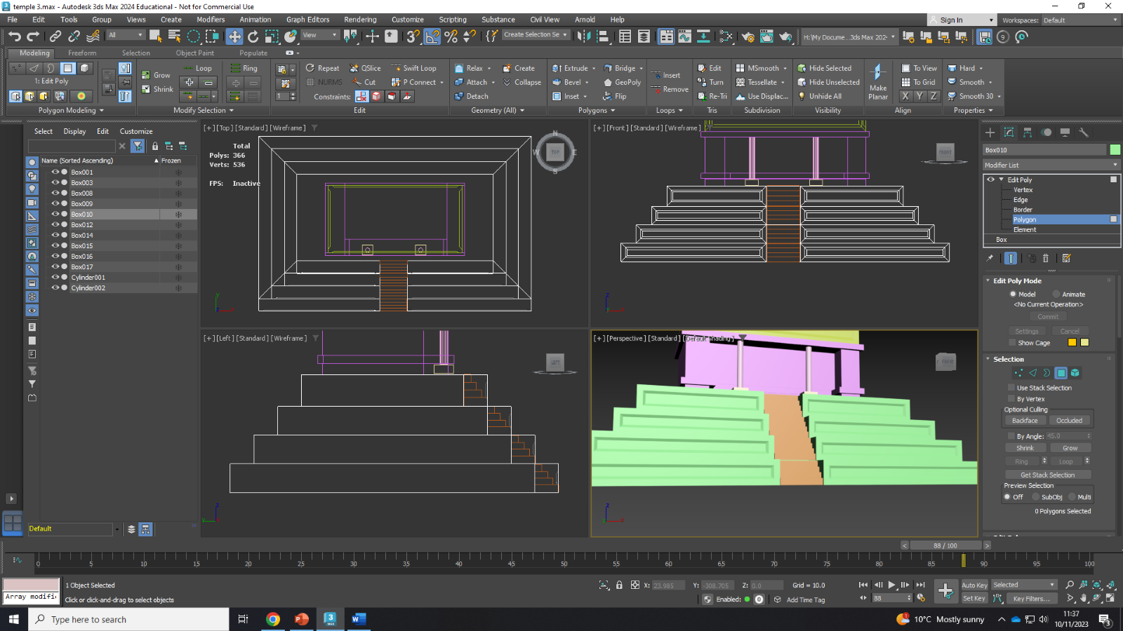
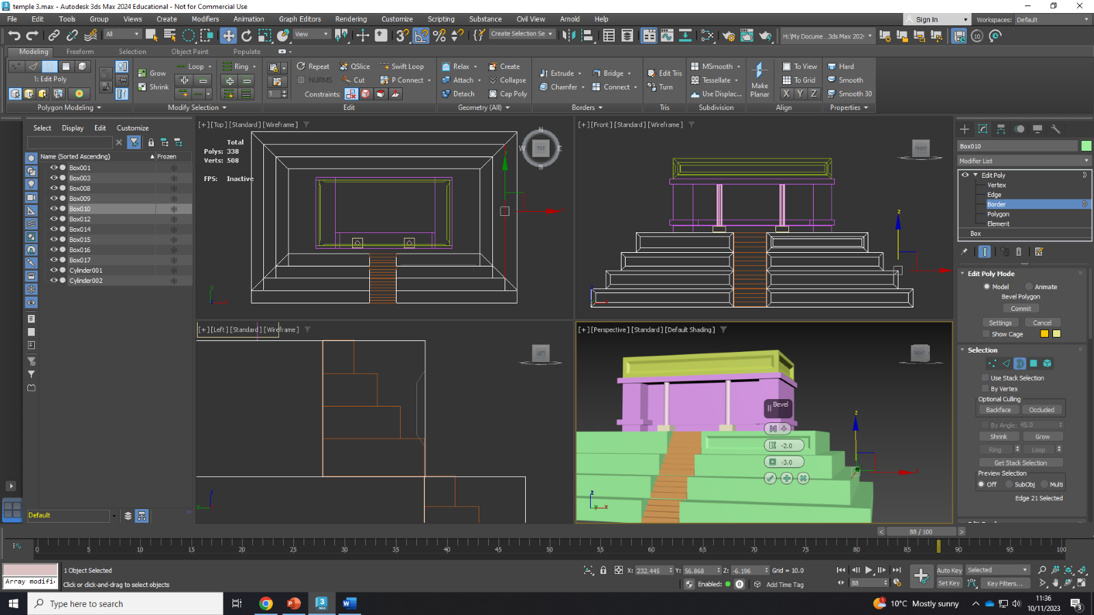
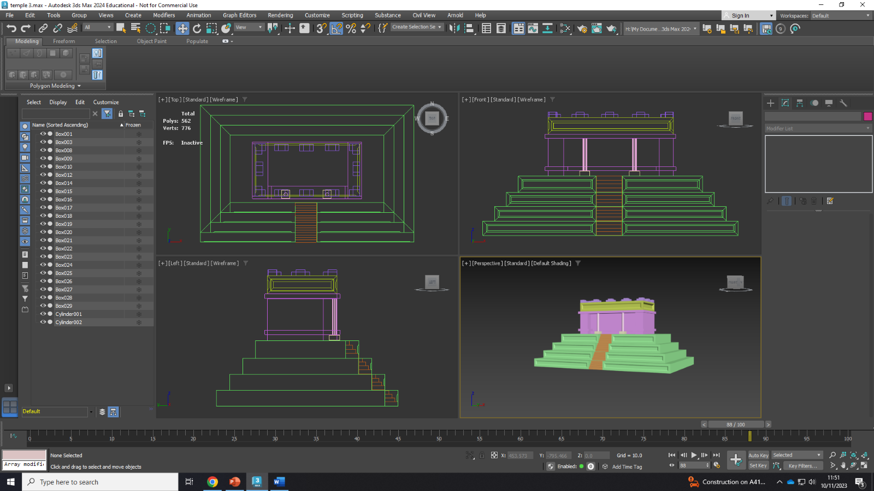
Modeling (temple 3)
Collums are added.
Temple pyramid steps are inset by 7.0 and then beveled.
Extra detail added on the roof of the temple by adding more boxes.

Slide 11
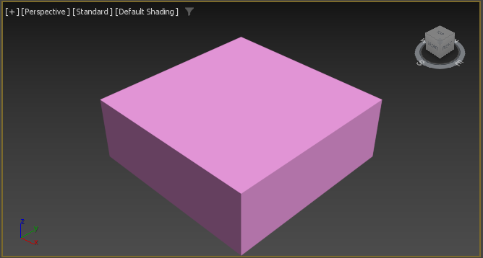
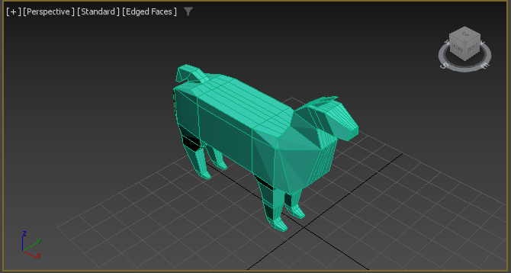
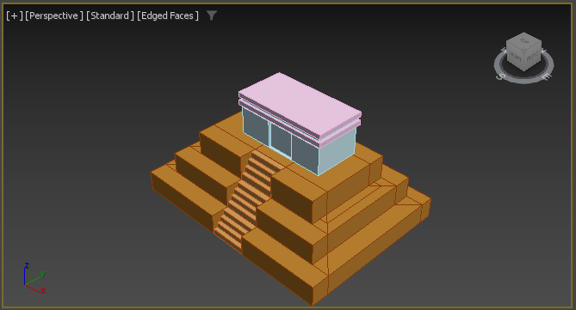
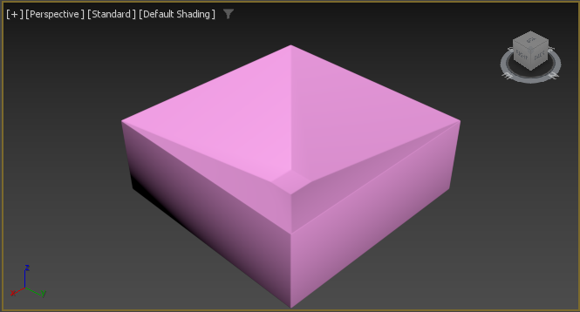
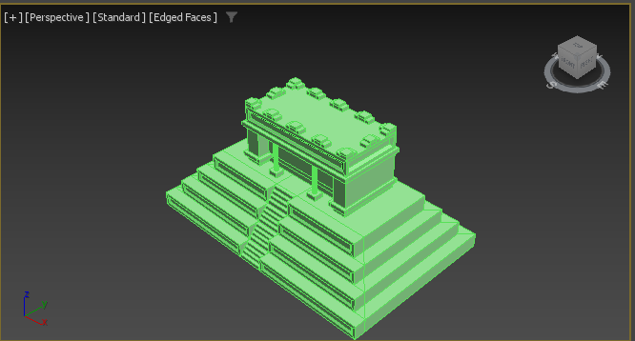
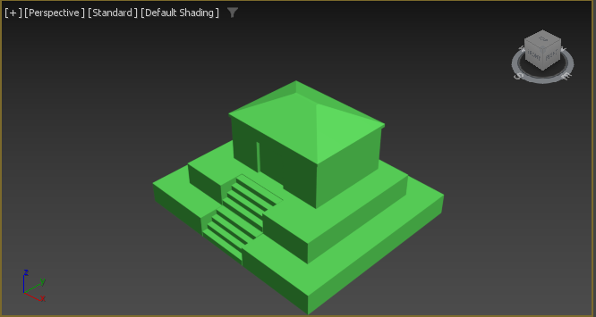
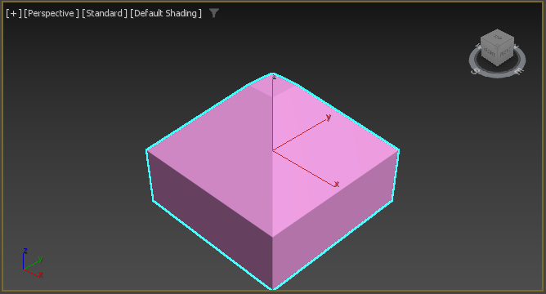
Modeling (all models)

Slide 12
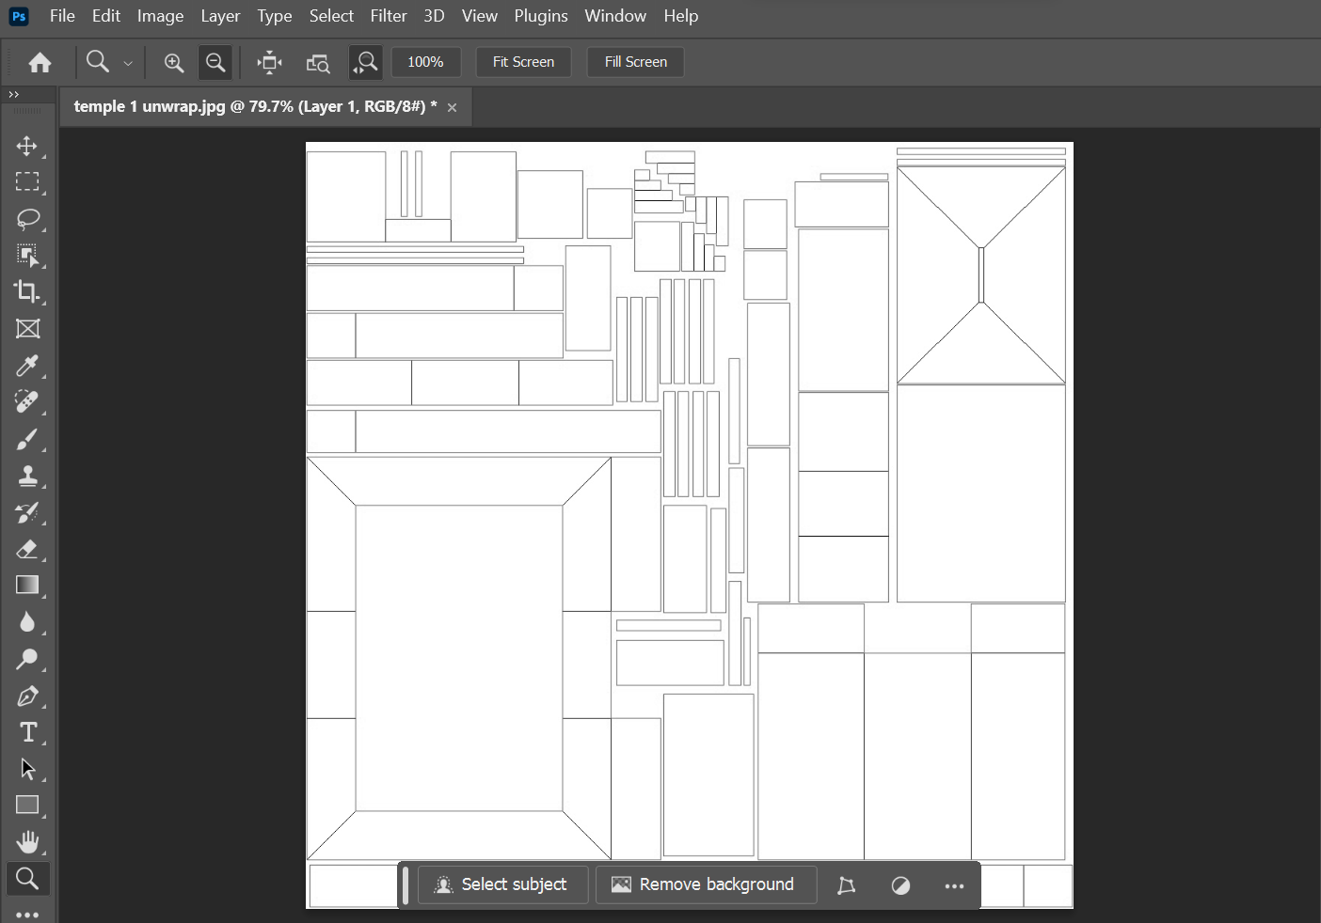
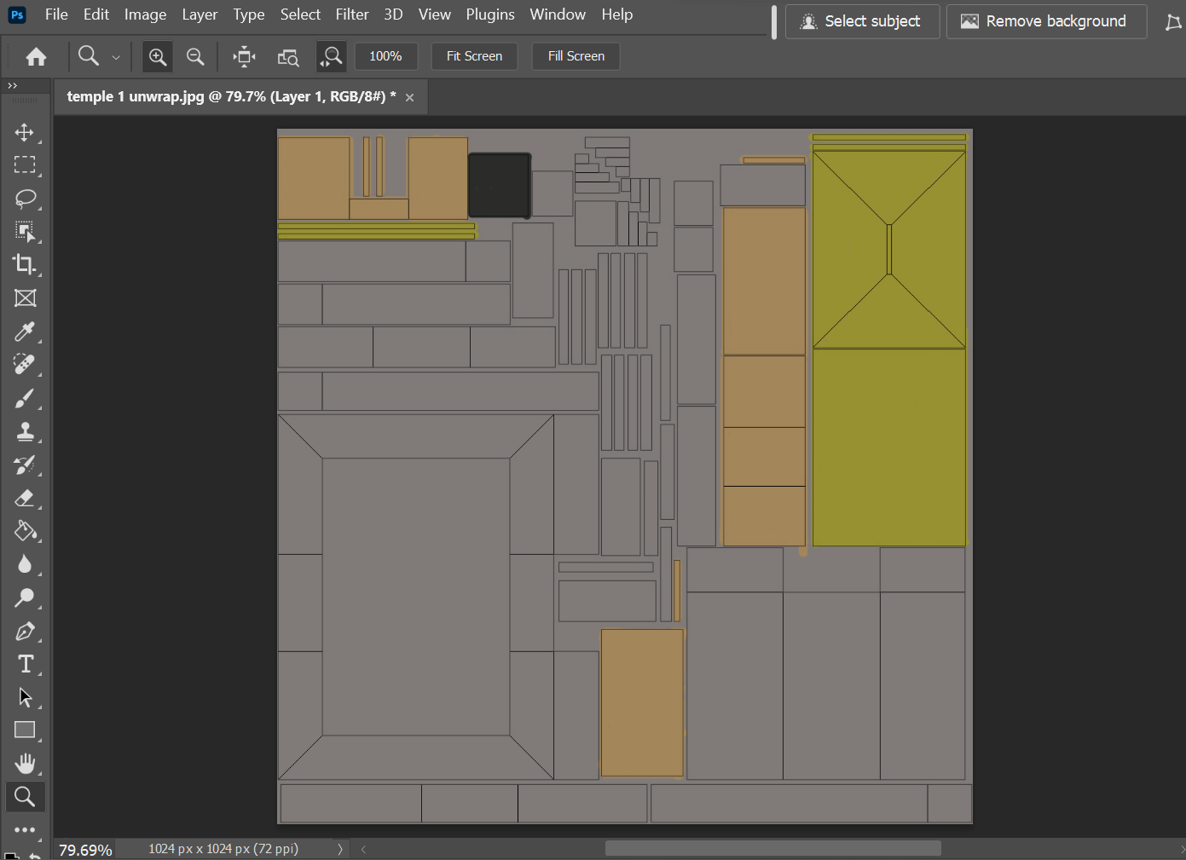
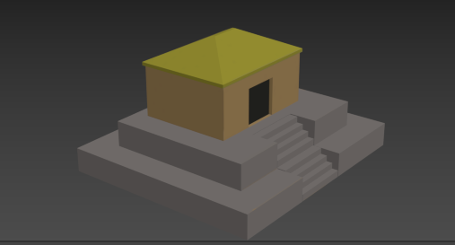
Texturing – diffuse ( temple 1)
First, the model is unwrapped, and that template is saved. Then the template was opened with Photoshop and the base colours for the model were added.

Slide 13
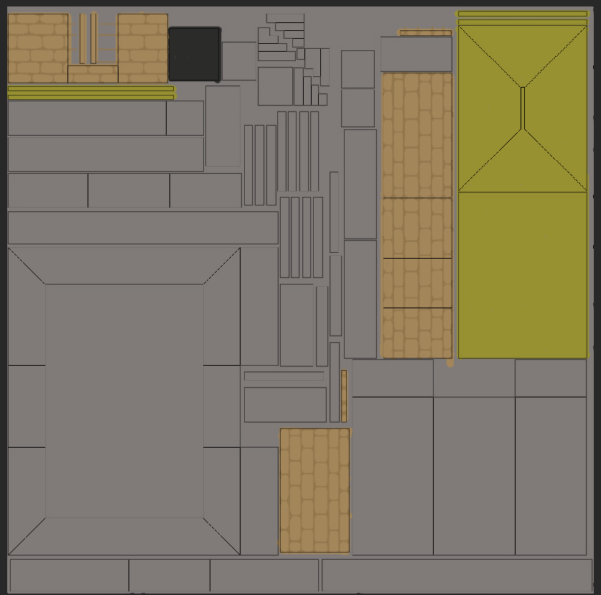
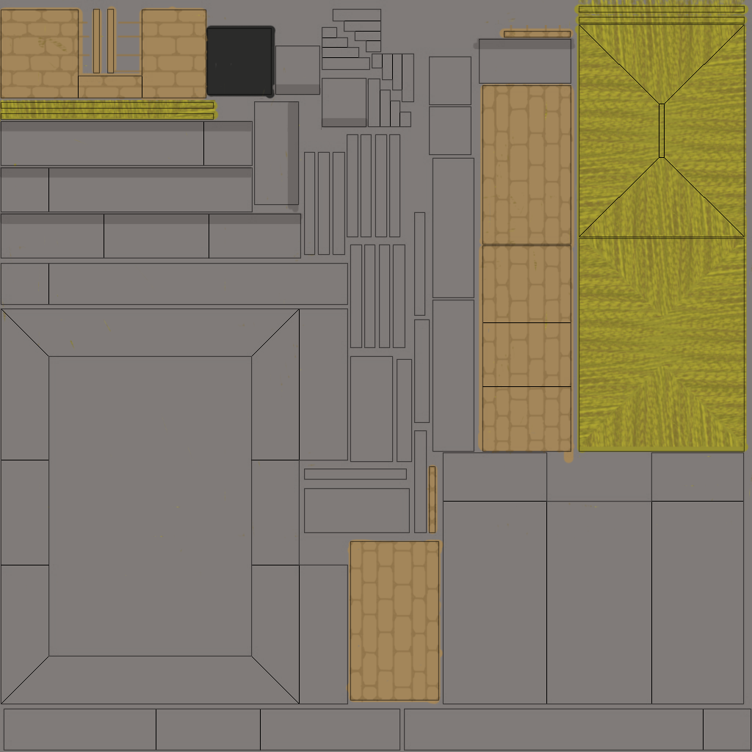
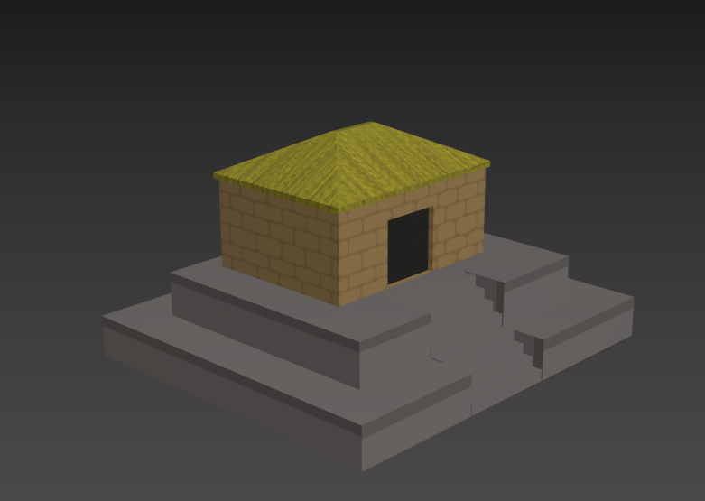
Texturing- diffuse (temple 1)
Then colour details were added. This took many attempts to line up the bricks correctly.

Slide 14
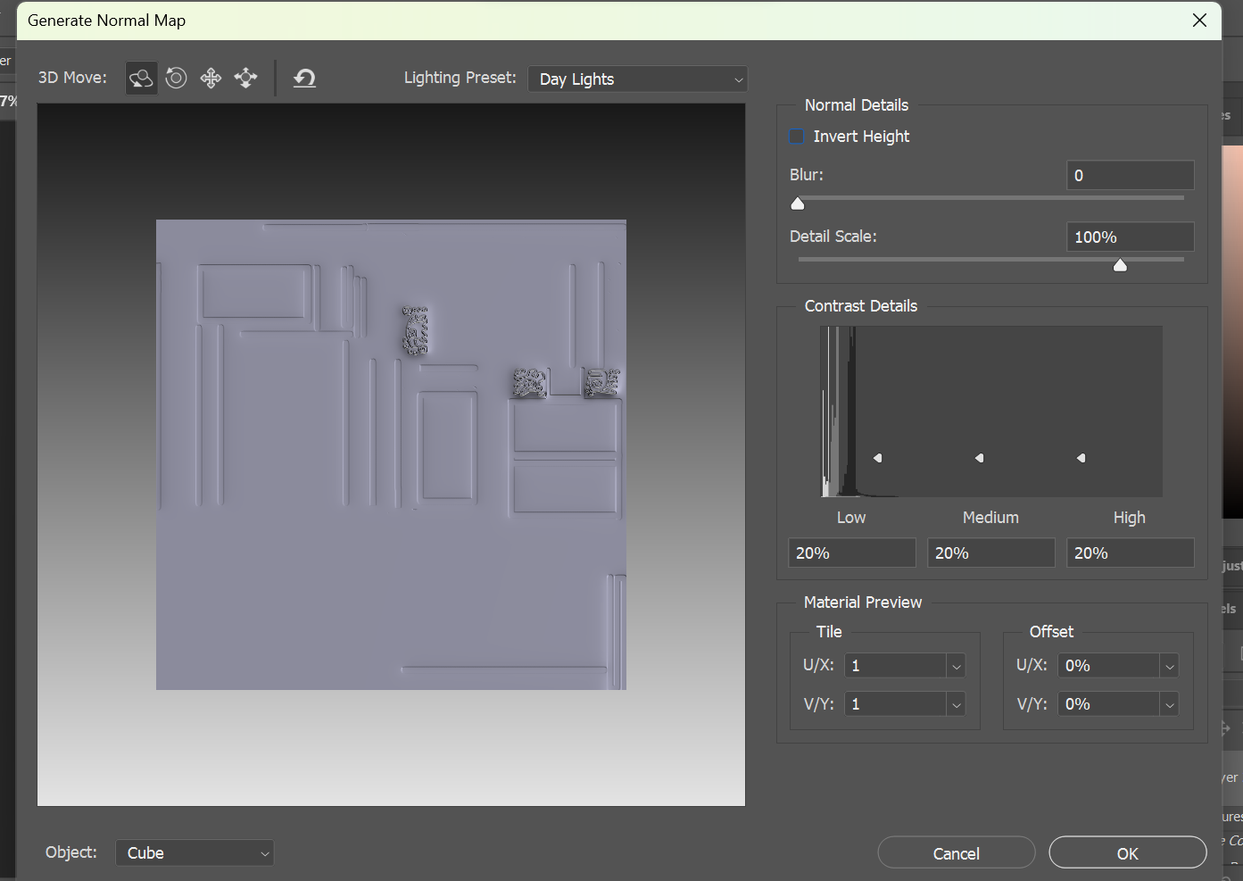
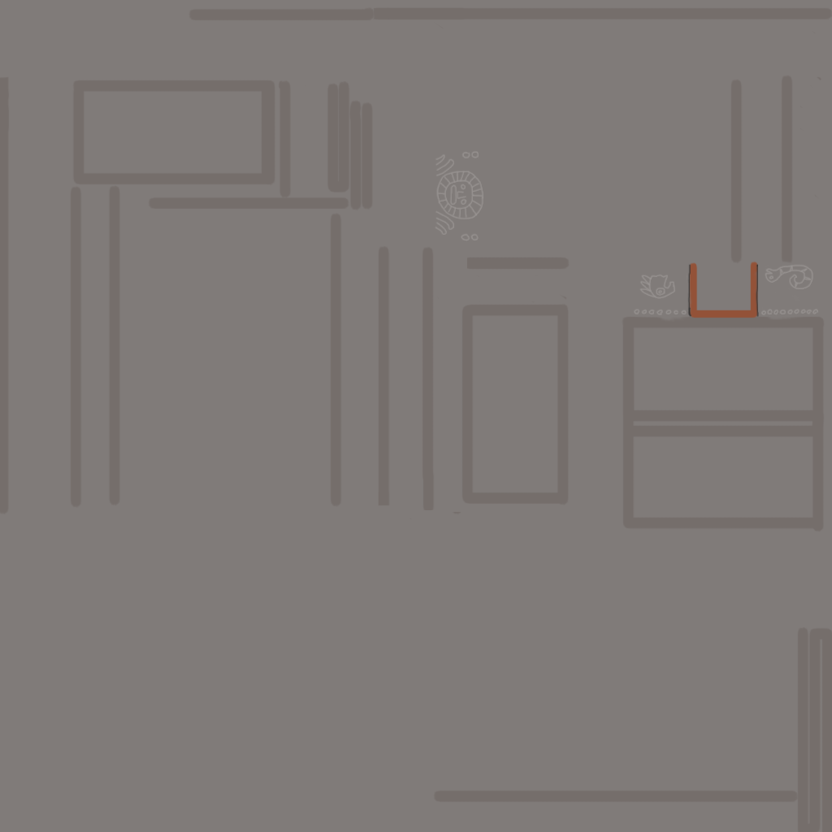
Texture- normal (temple 2)
Designs that were not on the diffuse map were drawn in using a lighter colour so the additional engravings would look raised. Then the layer was put through Photoshops 'generate normal Map' feature to create the normal map.

Slide 15
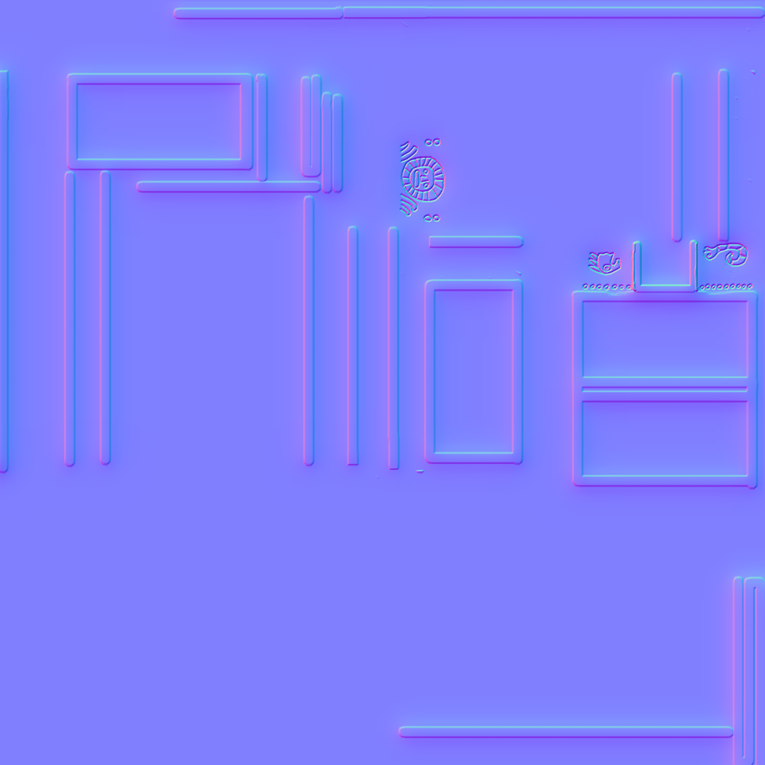
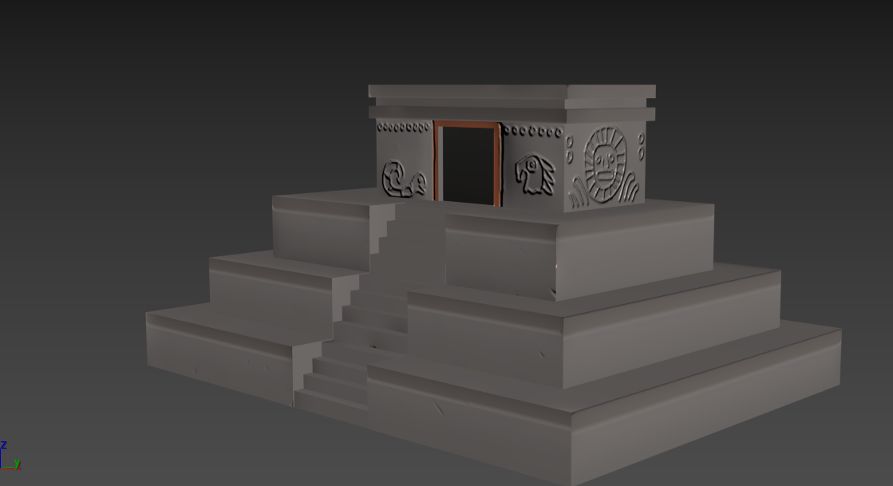
Texture- normal (temple 2)
Once the Normal map is rendered it then added to the object.

Slide 16
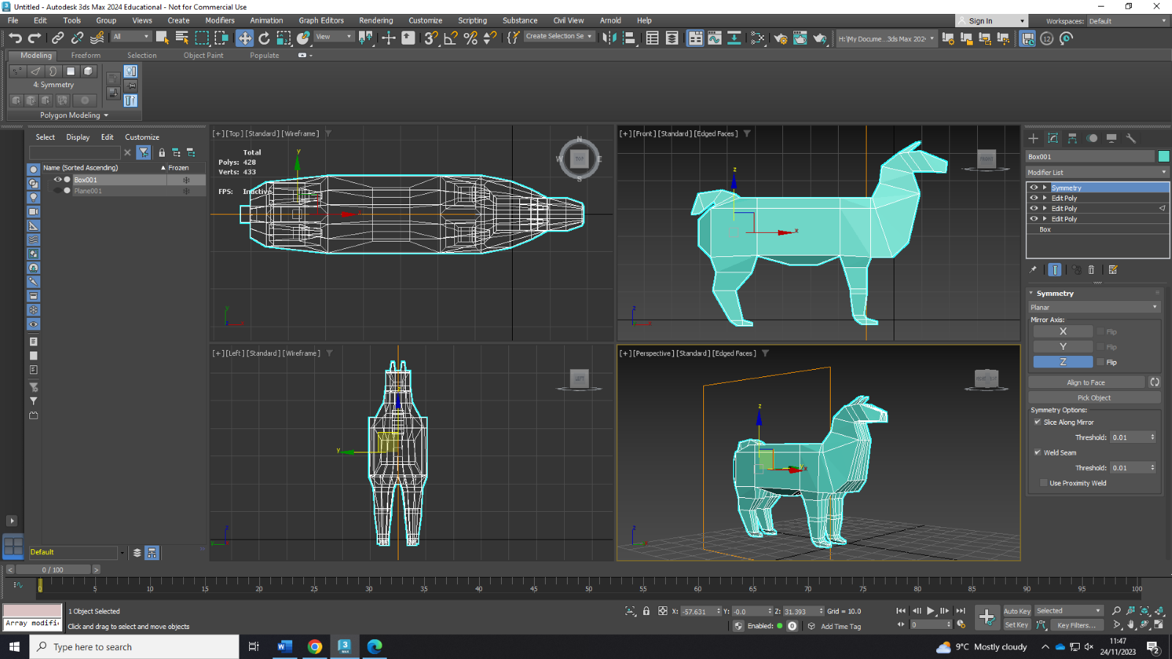
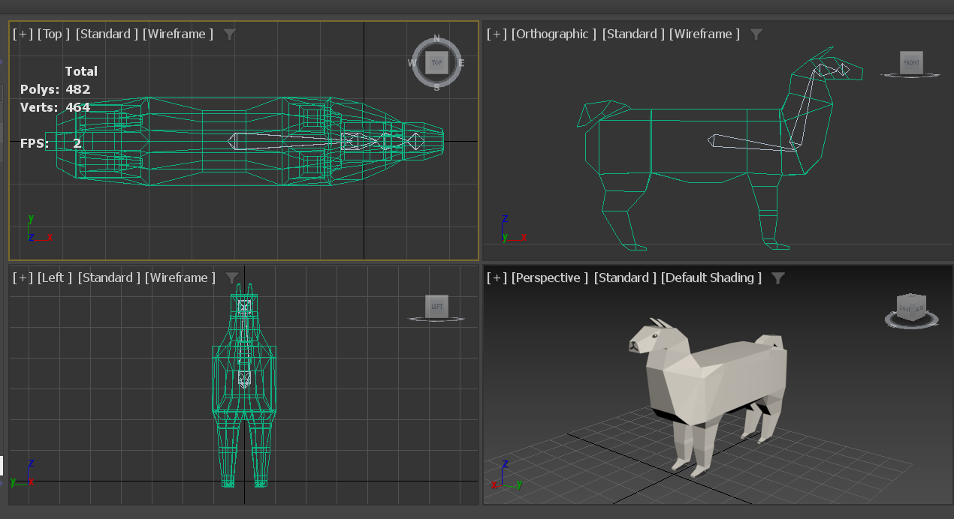
Animation (Llama)
The intended animation is for the llama to bend its head down and then return to the starting position.
The animation form that was chosen is bones. This was because the object that was being animated was a living creature and the intended animation involved only part of the object to move.

Slide 17
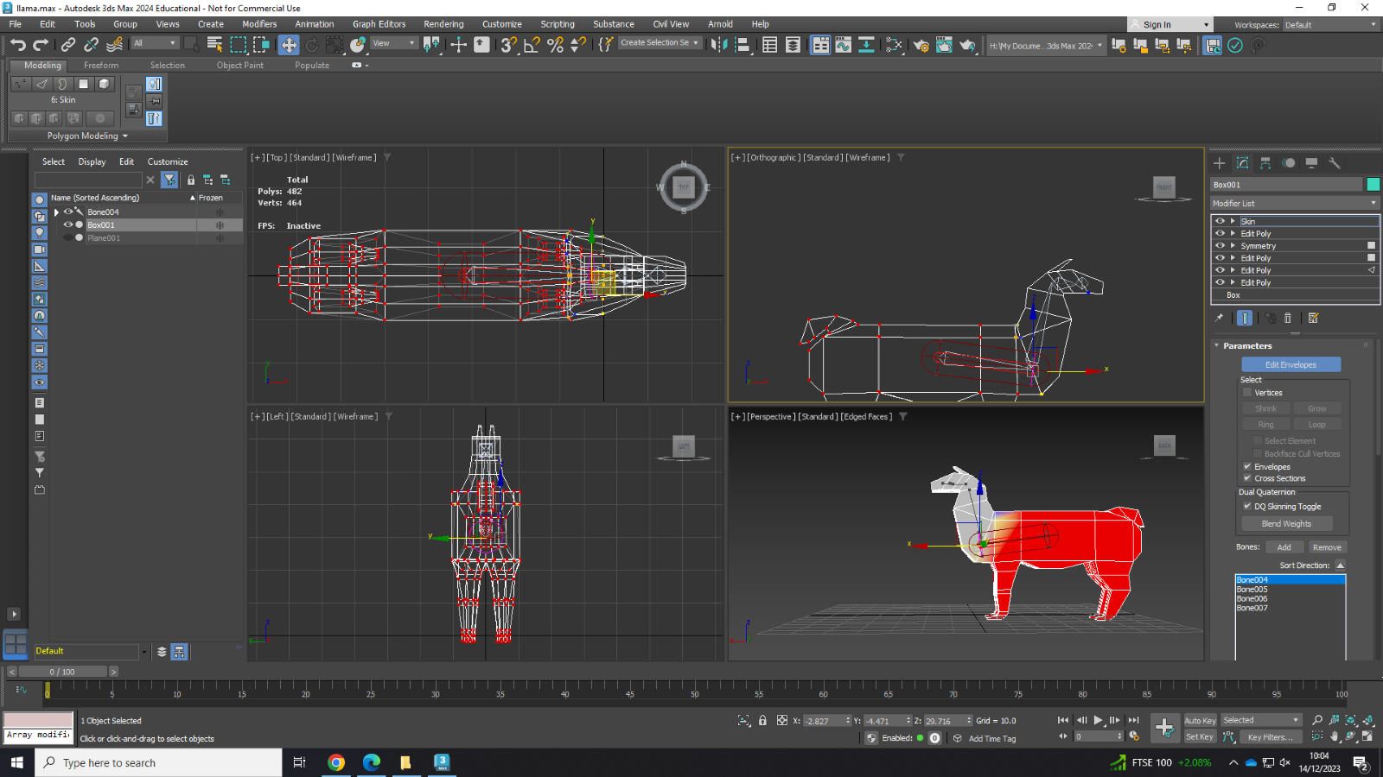
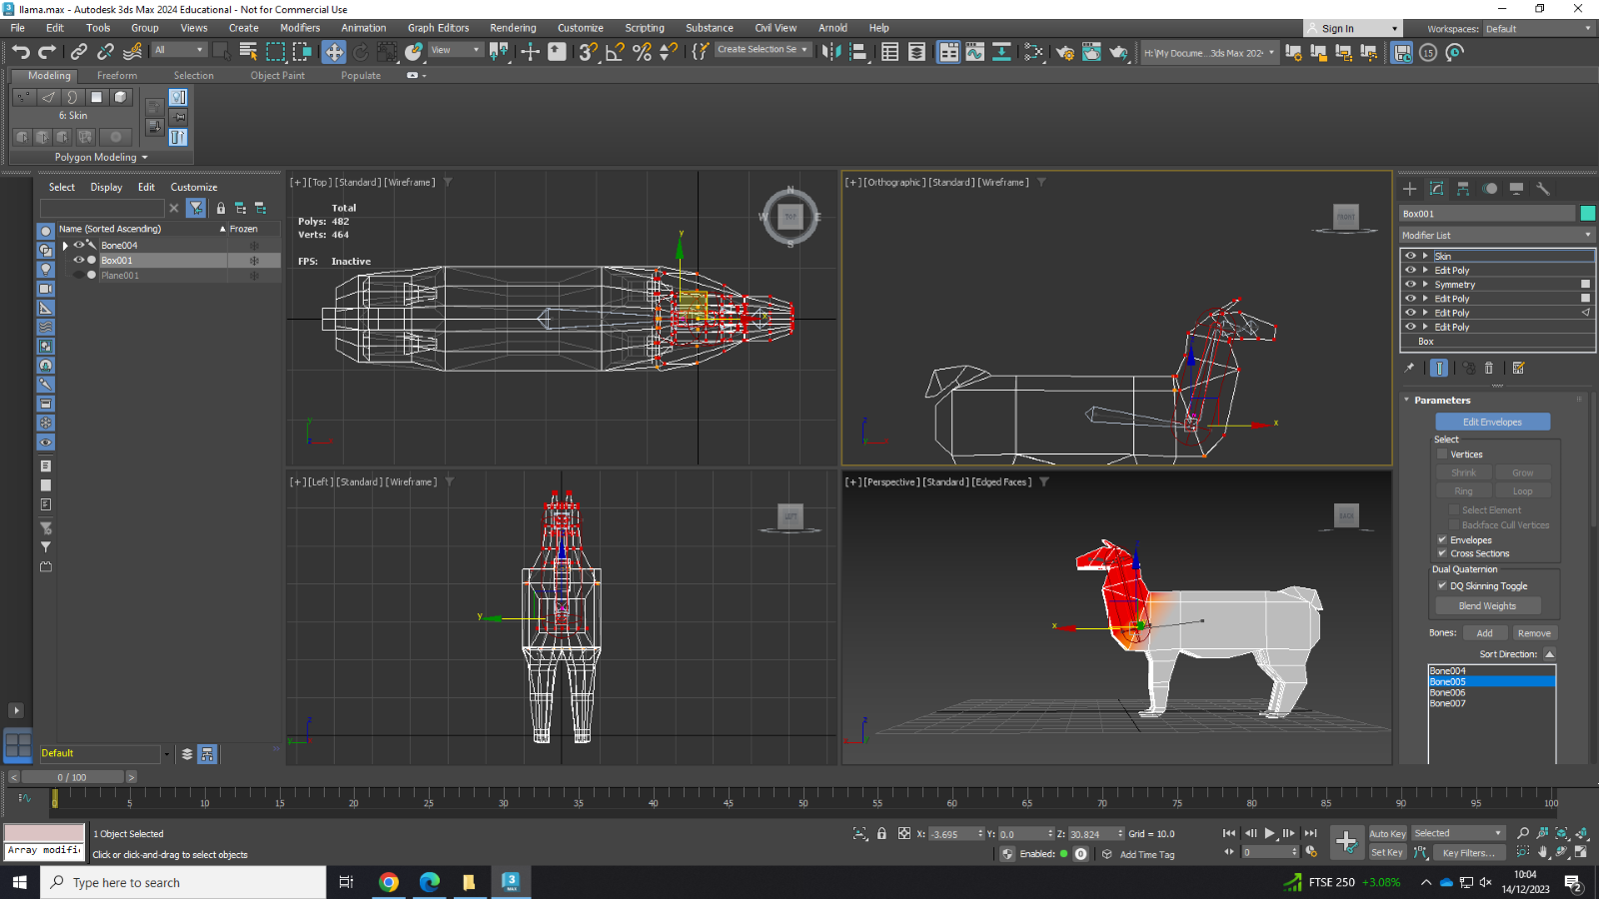
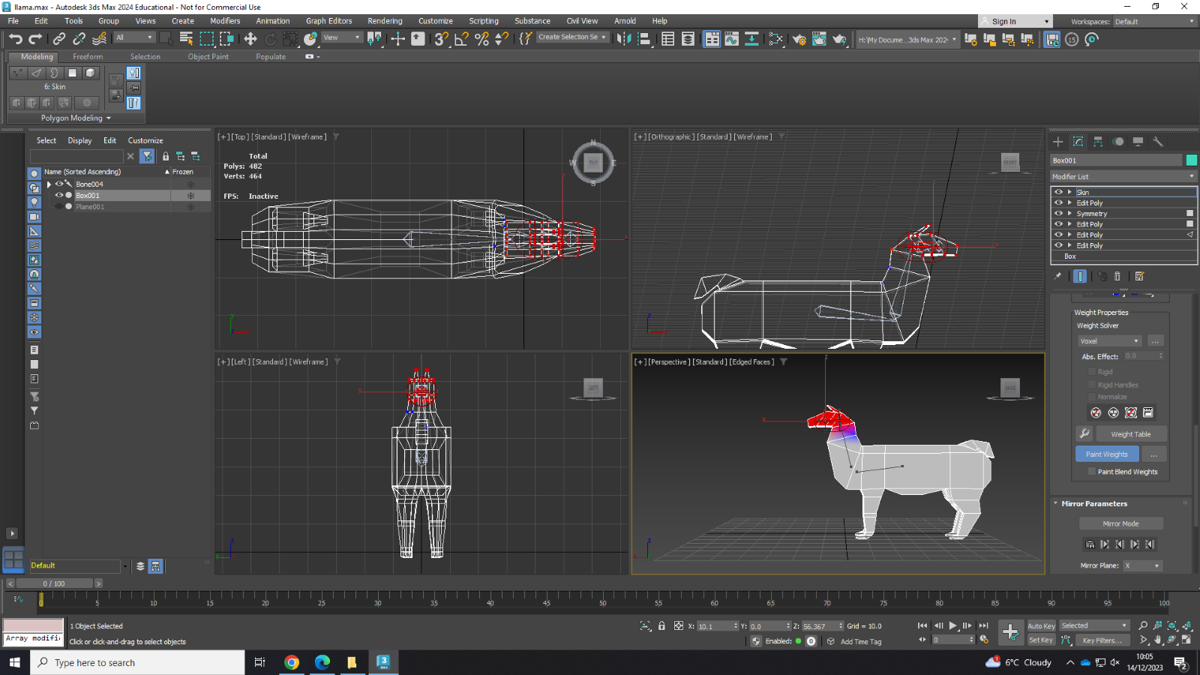
Animation (Llama)
Heatmap of bone 4's weighting
Heatmap of bone 5's weighting
Heatmap of bone 6's weighting

Slide 18
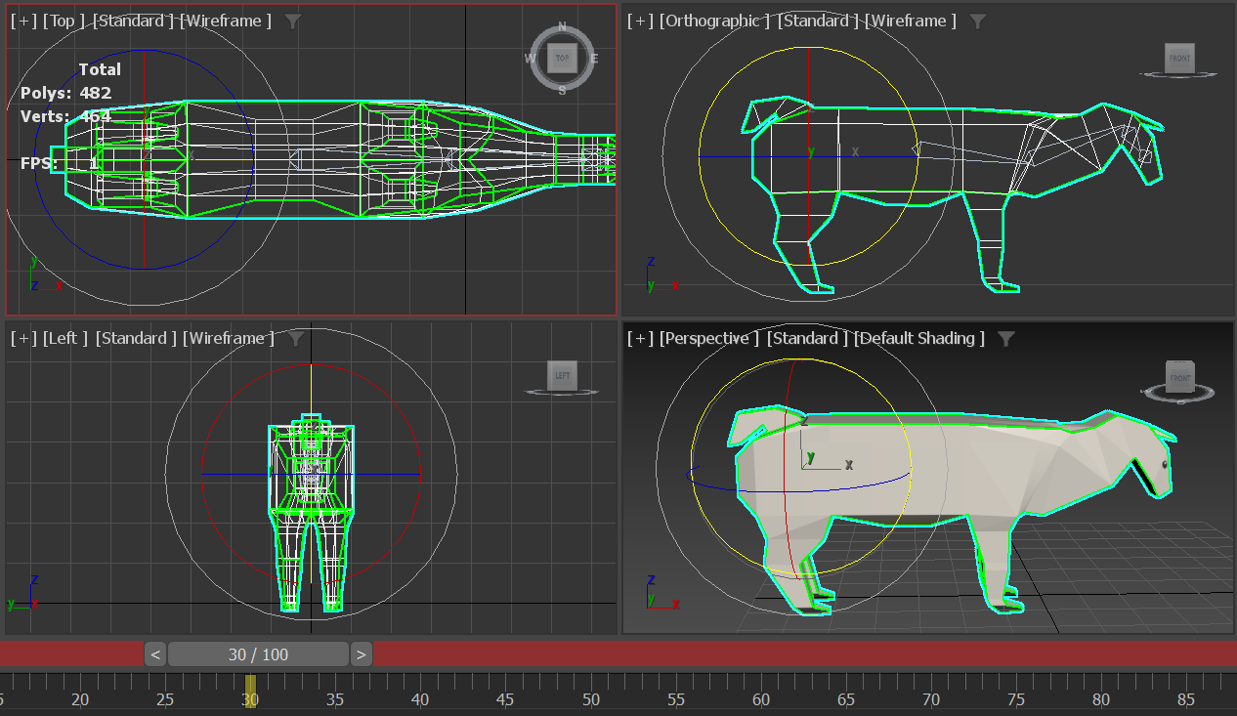
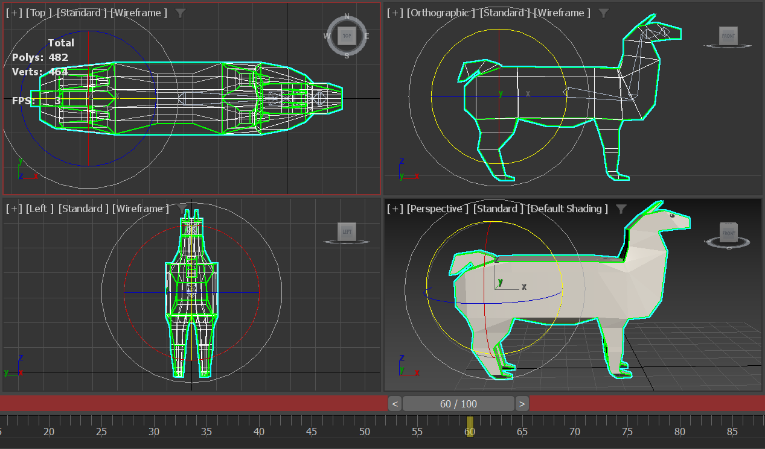
Animation (Llama)
The animation is set to 30 frames per second and the intended length for the animation is 2 seconds.
At the 30-frame mark, the neck bone ( bone 5) is rotated so the head is facing toward the ground. At the 60-frame mark, bone 5 is rotated back to the original position. This is to create the neck movement for the animation.

Slide 19
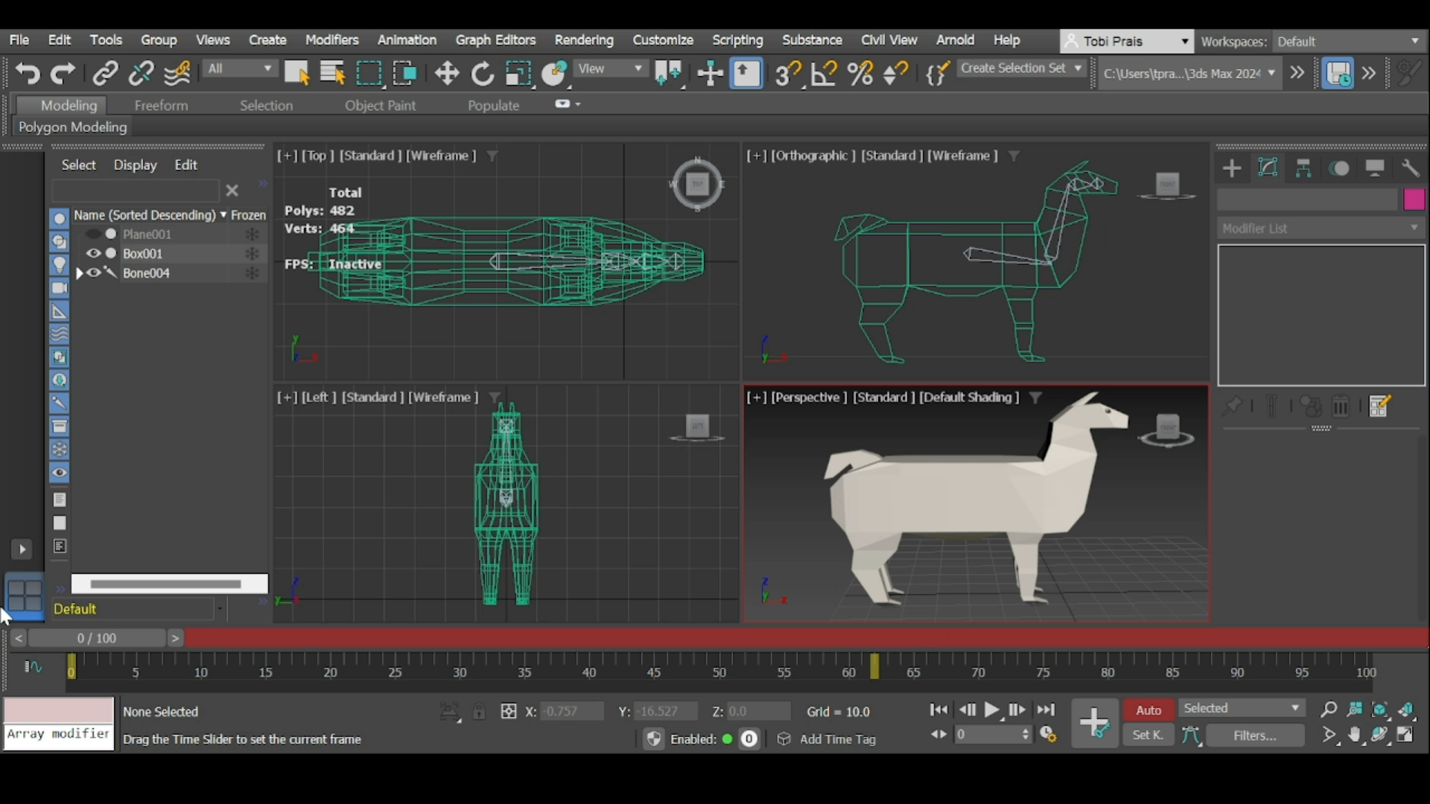
Animation (Llama)
The Animation of the neck moving.

Slide 20
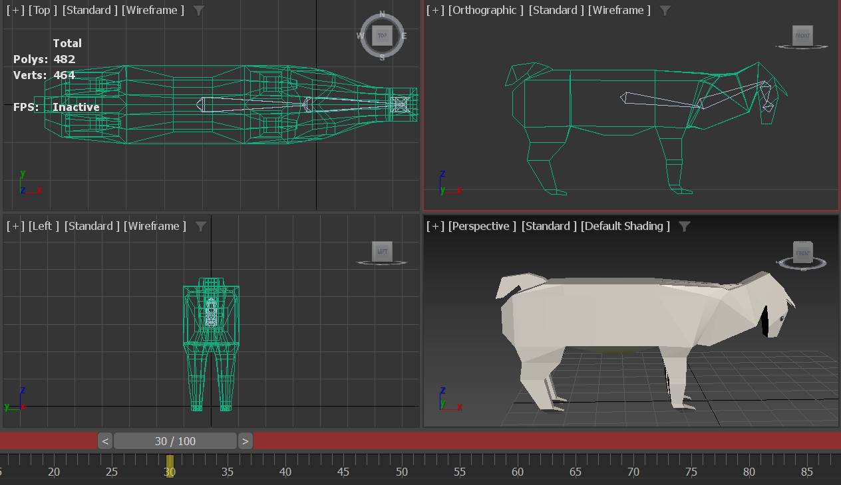
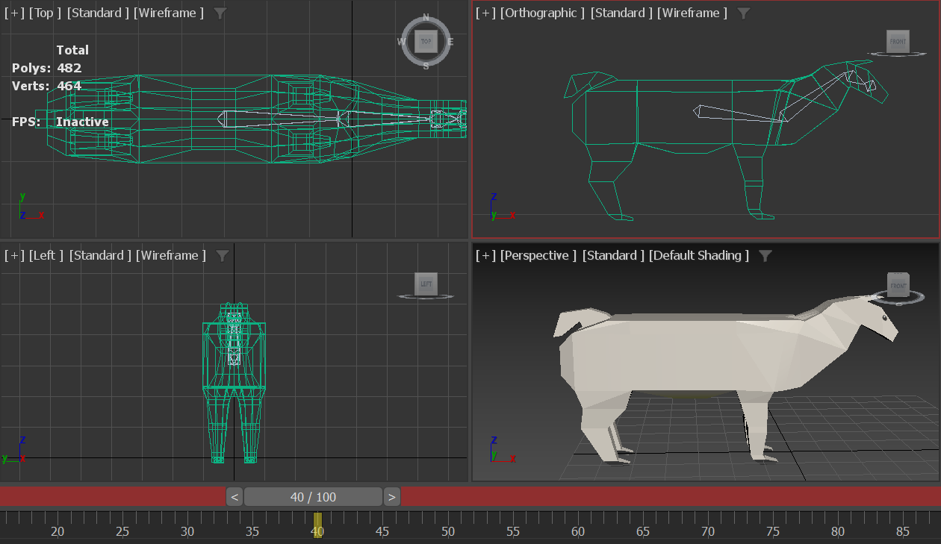
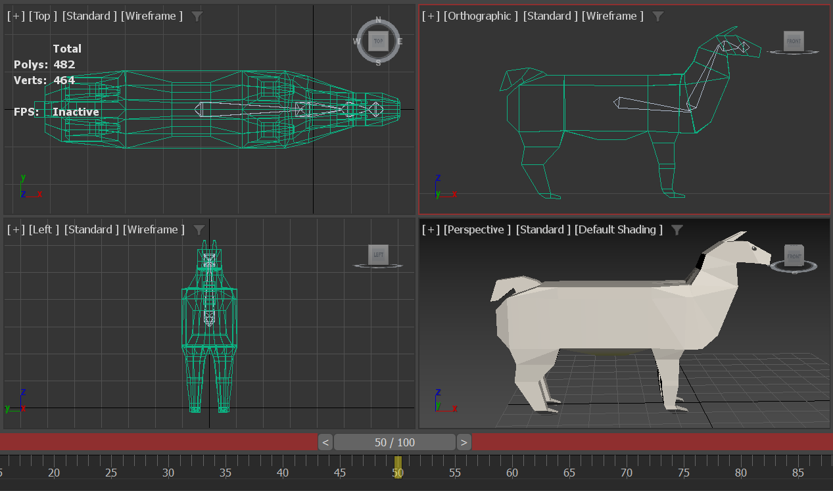
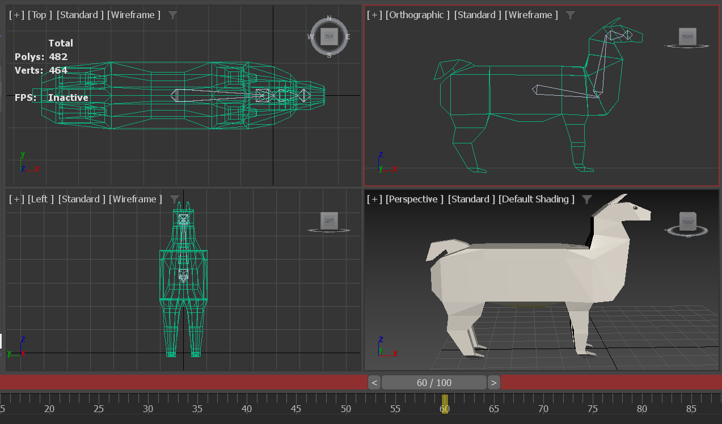
Animation (Llama)
At the 30 frame mark the head ( bone 6) is rotated so that it looks at the floor. Every 10 frames after that the head is rotated slightly so that it looks straight forward as the neck is moving.

Slide 21
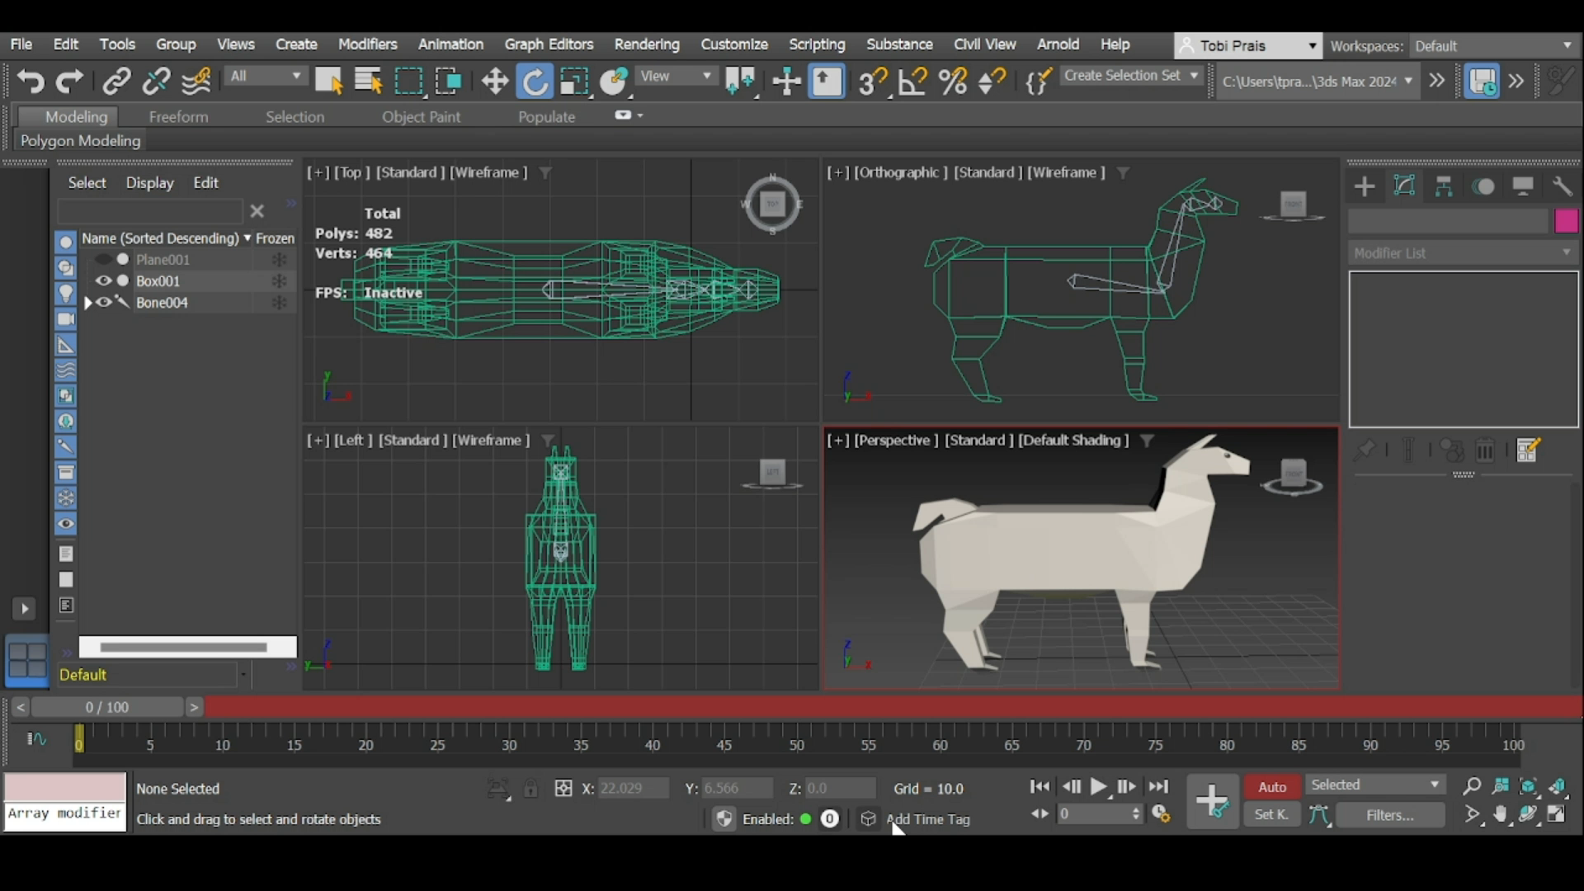
Animation (Llama)
Final
Animation

Slide 22
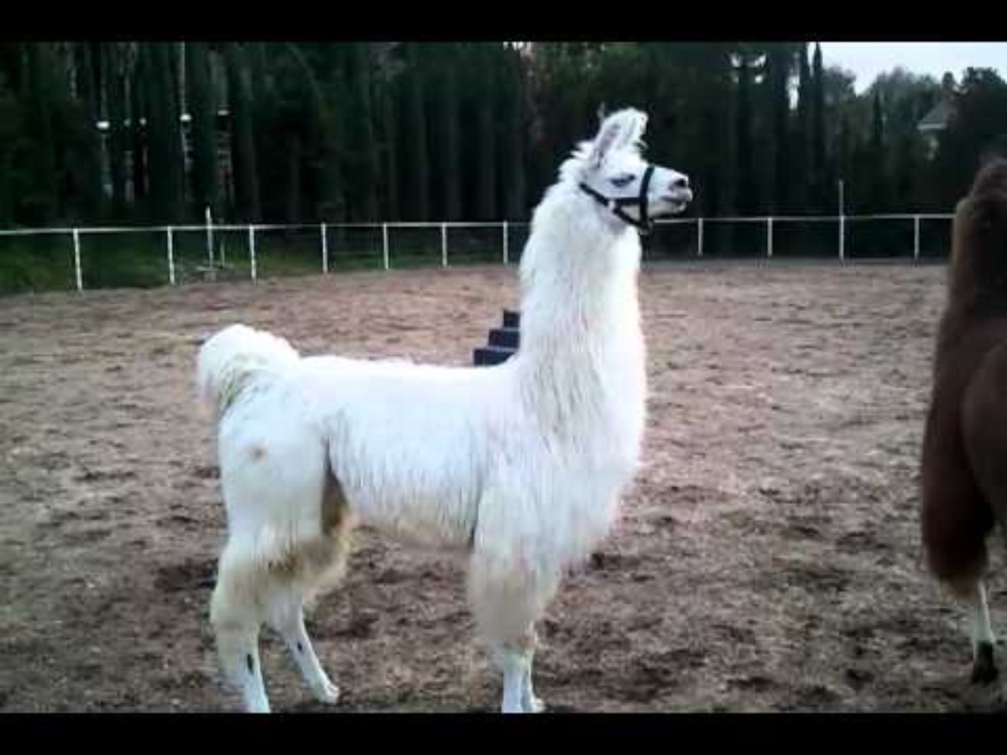
Sound Design
As the inhabitance of this level are llamas, one of the sounds to be created is the noise that llamas make. The basis for what the llama sound will be like is from ShangriLlama (2011).

Slide 23
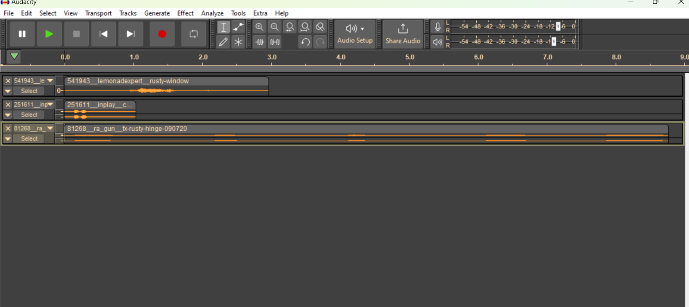

Sound Design
Base sounds:
Clown horn (inplay, 2014)
Rusty Window (LemonaidExpert, 2020)
Rusty Hinge (ra_gun, 2009)
All the base sounds were imported into Audacity.

Slide 24
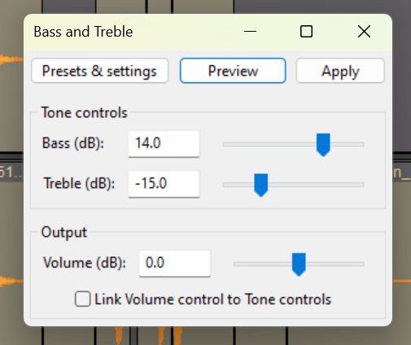
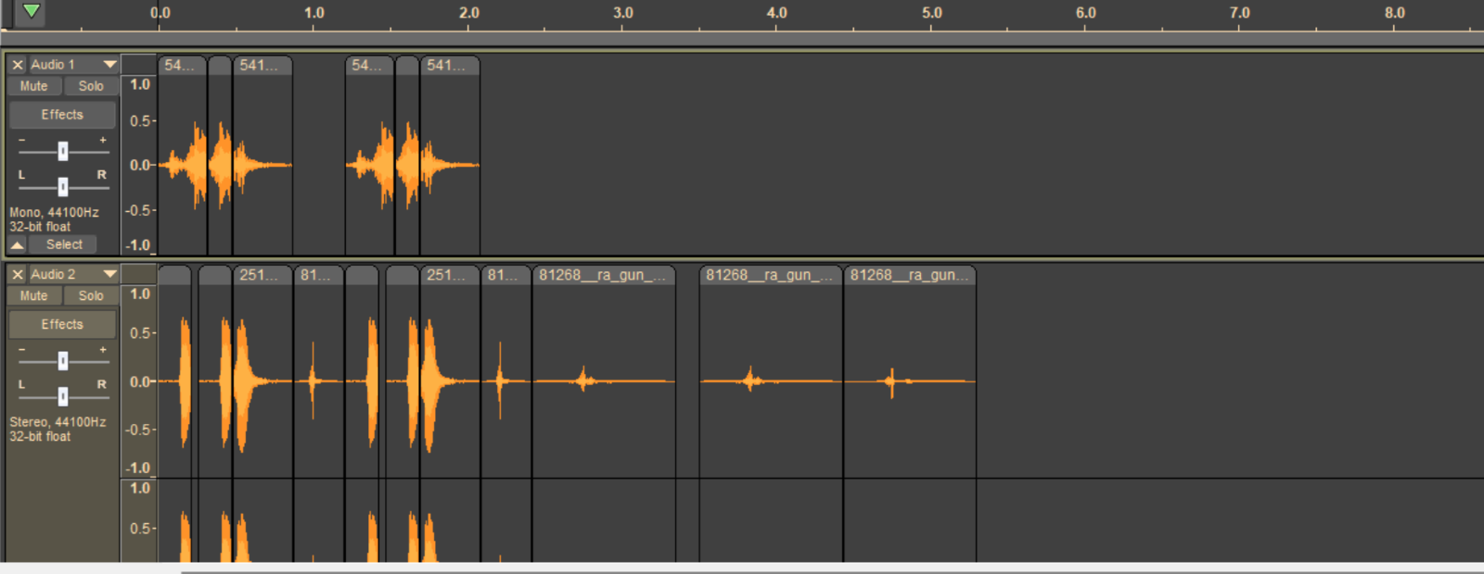
Sound Design
The sound samples were then edited together.
The pitch was raised by 3 semitones and the bass and treble levels were edited (as seen above). This was to make the sound slightly more natural sounding.

Slide 25
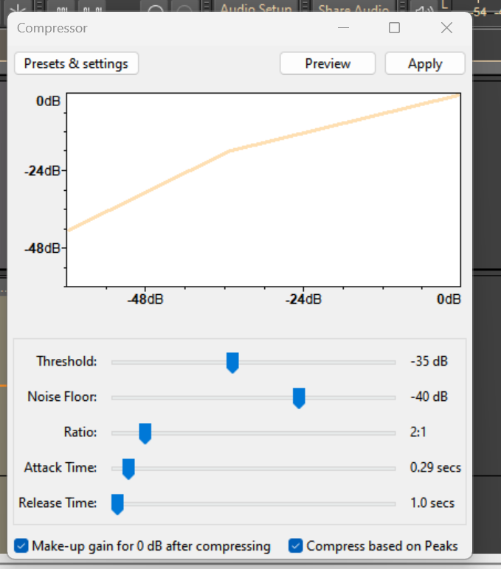


Sound design
Finally, the sound went through the compressor and a Loudness normaliser effect to reach the final sound created.

Slide 26
References
Gary Todd (2013). Painting of Tenochtitlan-Tlatelolco on Lake Texcoco. Available at: Painting of Tenochtitlan-Tlatelolco on Lake Texcoco | Flickr
inplay (2014) Clown_Horn.mp3. October 16. Available at: https://freesound.org/people/inplay/sounds/251611/
LemonaidExpert (2020) rusty window.mp3. November 2. Available at : https://freesound.org/people/Lemonadexpert/sounds/541943/
Mexicore (2015) Basic Aztec facts: AZTEC TEMPLES Available at: Basic Aztec facts: AZTEC TEMPLES (mexicolore.co.uk)
Bullfrog Productions (1991) Populous II: Trials of the Olympic Gods [video game] Electronic Arts
ra_gun (2009) FX-rusty hinge-090720.mp3. October 8. Available at: https://freesound.org/people/ra_gun/sounds/81268/
ShangriLlama (2011) Llama Sounds | Llama Alarm Cry. January 10. Available at: https://www.youtube.com/watch?v=p_JIUS9PPxw

